Slide 1
Genetic Algorithm for Travelling Salesman Problem
Presented By –
Siddharth Bhadri, Suyash Khemka & Vaidehi Kabra

Slide 2
Introduction -TSP
It is a NP complete problem algorithm problem in the field of computer science. It is focused on optimization.
A set of cities and distance between every pair of cities, the problem is to find the shortest possible route that visits every city exactly once and returns to the starting point.

Slide 3
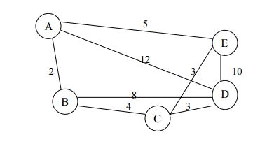
Problem Statement
The traveling salesman problem consists of a salesman and a set of cities. The salesman has to visit each one of the cities starting from a certain one (e.g. the hometown) and returning to the same city. The challenge of the problem is that the traveling salesman wants to minimize the total length of the trip.

Slide 4
Introduction - Genetic Algorithm
Genetic Algorithm (GA) is metaheuristic inspired by the process of natural selection that belongs to the larger class of evolutionary algorithms (EA). Genetic algorithms are commonly used to generate high-quality solutions to optimization and search problems by relying on bio-inspired operators such as mutation, crossover and selection.

Slide 5
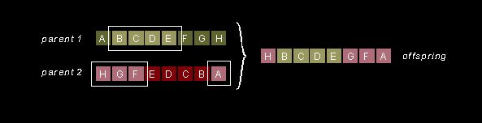
Evolution in genetic Algorithm
Selection: which equates to survival of the fittest
Crossover: which represents mating between individuals
Mutation: which introduces random modifications.
Ex:

Slide 6
Algorithm
A specified number of paths are taken.
The total distance is calculated for each path and threshold value is applied to it.
Mutation is applied to all the paths that are below the threshold value.
This happens for a fixed number of counts.
The path with the least total distance is calculated and given as the result.
Parallelism in CUDA
One Thread is assigned to a path and computation is carried out.

Slide 7
Performance Comparison

Slide 8
Thank You

